Slide 1


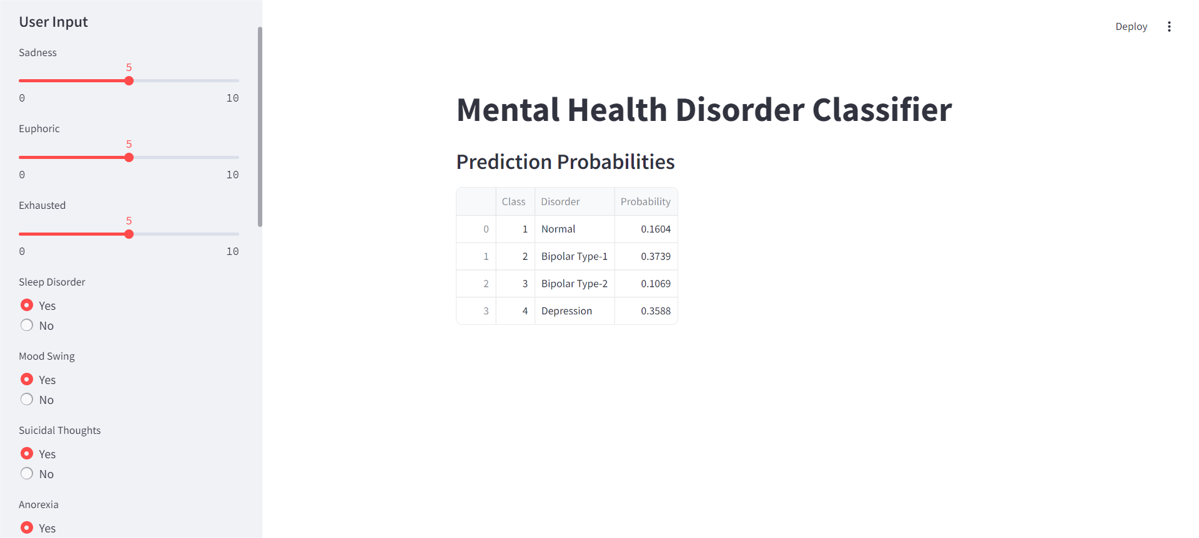
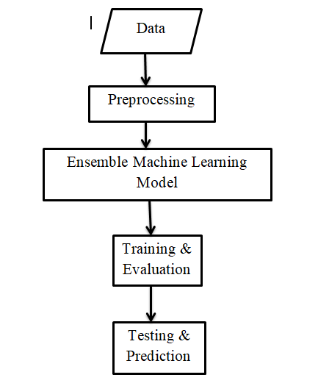
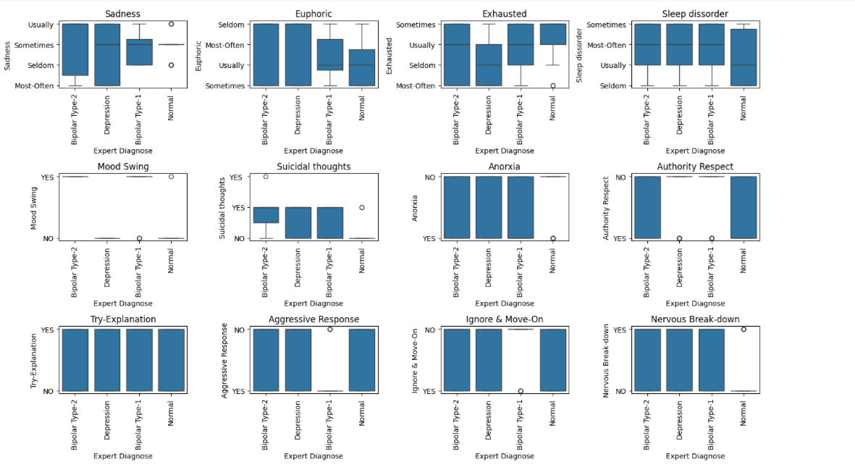
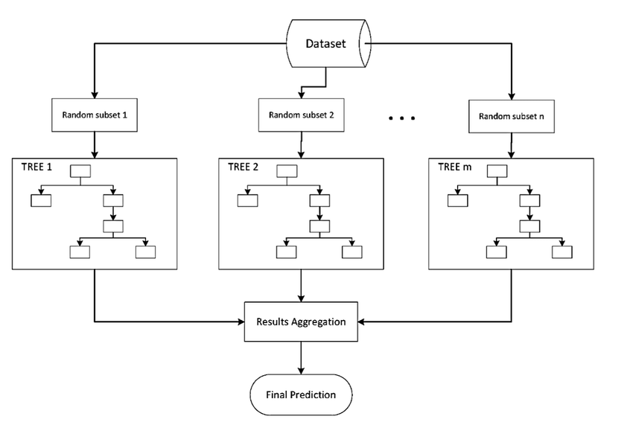
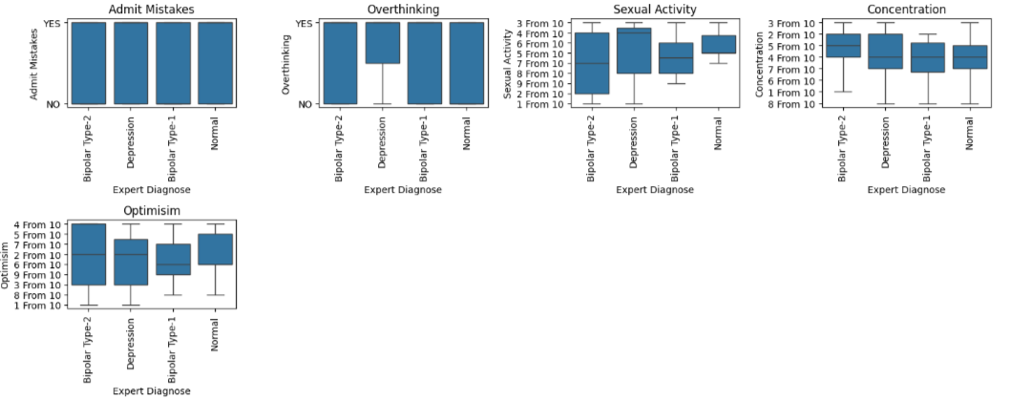

MENTAL HEALTH DISORDER CLASSIFICATION
Department: MCA
Name : Radhika(2022D1R017)|Sonika Thakur(2022D1R007)
Abstract
Deployed Model
A mental disorder is characterized by significant disturbances in cognition, emotional regulation, or behavior, often leading to distress or impairment in important areas of functioning. The COVID-19 pandemic in 2020 saw a notable increase in anxiety and depressive disorders globally. Anxiety disorders, affecting 301 million people worldwide in 2019, involve excessive fear, worry, and related behavioral disturbances, causing significant distress or impairment. Types include generalized anxiety disorder, panic disorder, social anxiety disorder, and separation anxiety disorder. This project contains two main parts: - Analyze and Prediction. Effective psychological treatments and, in some cases, medication are available. People with bipolar disorder also face an increased risk of suicide. Despite effective prevention and treatment options, access to care remains limited for many, compounded by stigma, discrimination, and human rights violations. Depression, affecting millions globally, differs from usual mood fluctuations and poses an increased risk of suicide. Bipolar disorder, experienced by 40 million individuals, involves manic symptoms like euphoria, increased activity, and impulsivity, along with depressive episodes.
Innovation & Impact
INNOVATION:
Neuroscientific and Psychological Research
Patient-Centered Approaches
AI based diagnosis
IMPACT:
Clinical practice, research, public health, insurance, social perceptions, and patient experiences.
Functional Workflow
Data Analysis
Ensemble Model
Language(s) | Technology Stack
LANGUAGES:
PYTHON
TECHNOLOGY STACK:
MACHINE LEARNING
DEEP LEARNING
Libraries:
SCIKIT-LEARN
TENSOR FLOW

